Slide 1

Conflict Resolution
Module 3
Pedro Jr. Vicente Valdez

Slide 2


There are a variety of hot and cold topics we encounter.
Hot Topics:
Direction of the project
Workload distribution
What methodology to use
Scheduling meetings
Cold Topics:
Workload distribution
Deliverable deadline commitments

Slide 3

Hot topic: Project Direction (Methodology)

Slide 4
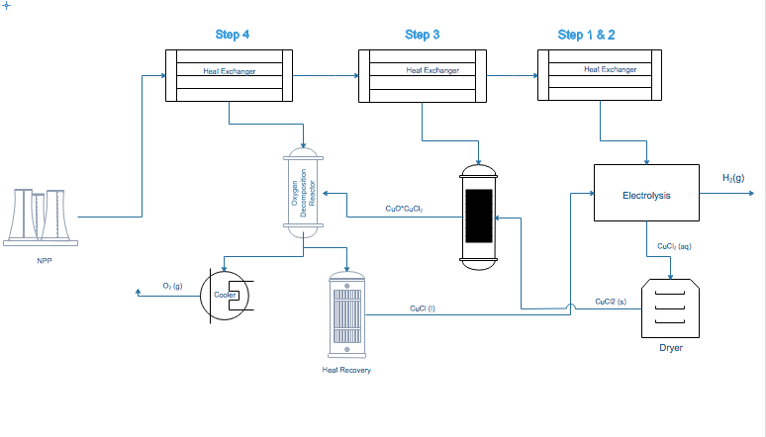
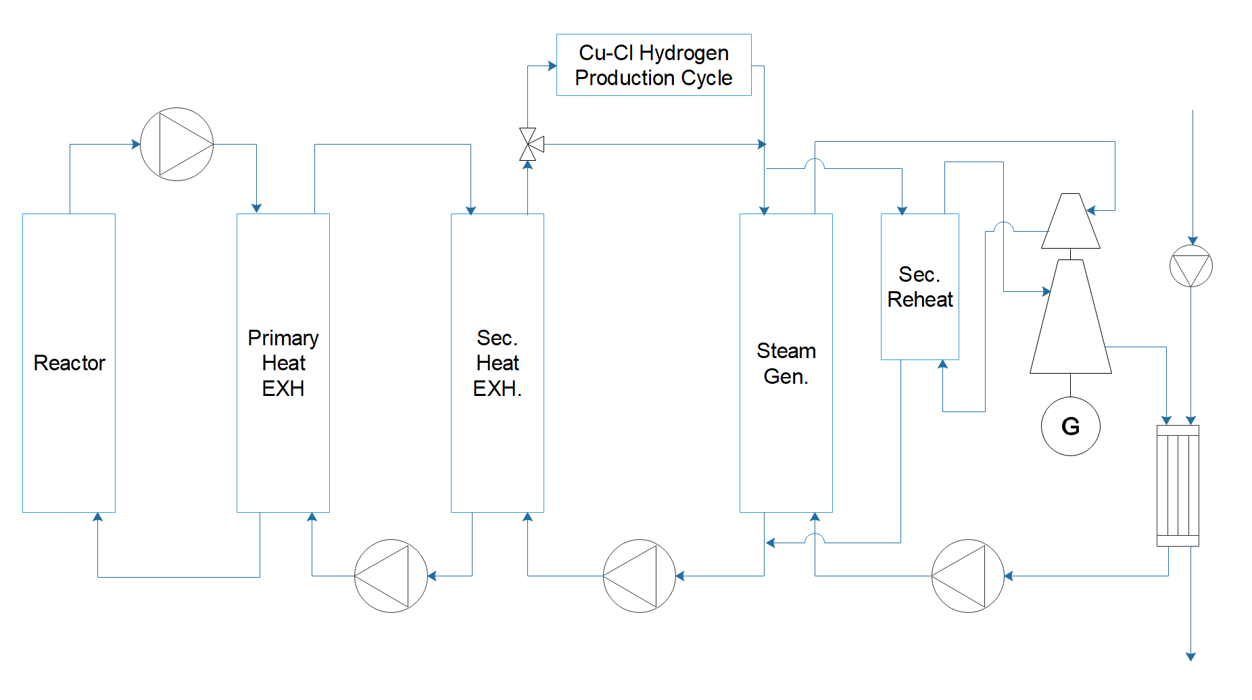
Background: Integration of Nuclear Power with Hydrogen production and renewables.

Slide 5






Managing
Self
Managing Conversation
Managing Relationships
Not everyone is on the same page.
Preparation for meetings and discussions is sometimes lacking
Criticism can sometimes be taken personal
Each person believes their Idea is the best, this diversity of ideas causes delays because of competing views.
(Beginning of the project) Openness to other ideas or criticism was minimal.
Take a more active role in discussions and reading the material before meetings
Explain our points of view more deeply for everyone's understanding
Putting ourselves in each others shoes
Patient explanation of methodologies to eventually converge in a single view or idea.
Debating some of this ideas with our academic advisor

Slide 6

Takeaway points:
It's important to reflect and reframe to understand everyone's perspective
Sometimes having a third party is effective for conflict resolution
Good relationship between team members is important for effective communication

